Slide 1
Entelect - Thutong
BY Digital blacksmiths

Slide 2
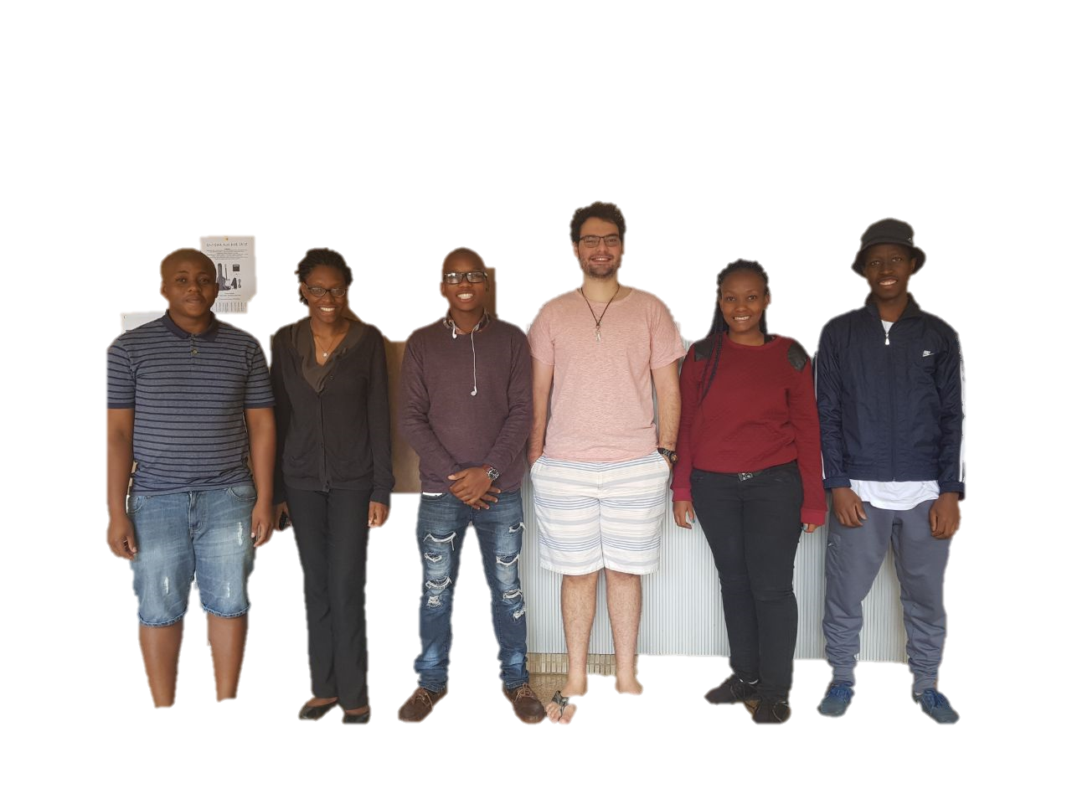
The Team: DiGital BlackSmiths
Tlou
Oluwatosin
Fiwa
Daniel
Lebogang
Lesego
As a team we are dedicated in striving to archive the most out of the Software Engineering project both as a learning tool leap into industry level project and also forecast our academic knowledge and skills acquired through our undergraduate academic career.

Slide 3
Thutong Project
The Project is a response to the problem that Thutong Site Learning Centre was formed to make a meaningful difference to South Africa’s education rank by developing and producing remarkable educational results through ICT initiatives.
Project Description:
Create a mobile friendly and easily maintainable website for all learners that follow the SA School Curriculum in order to improve learners’ subject results and ICT skills, by providing free and accessible educational information via technological devices.

Slide 4
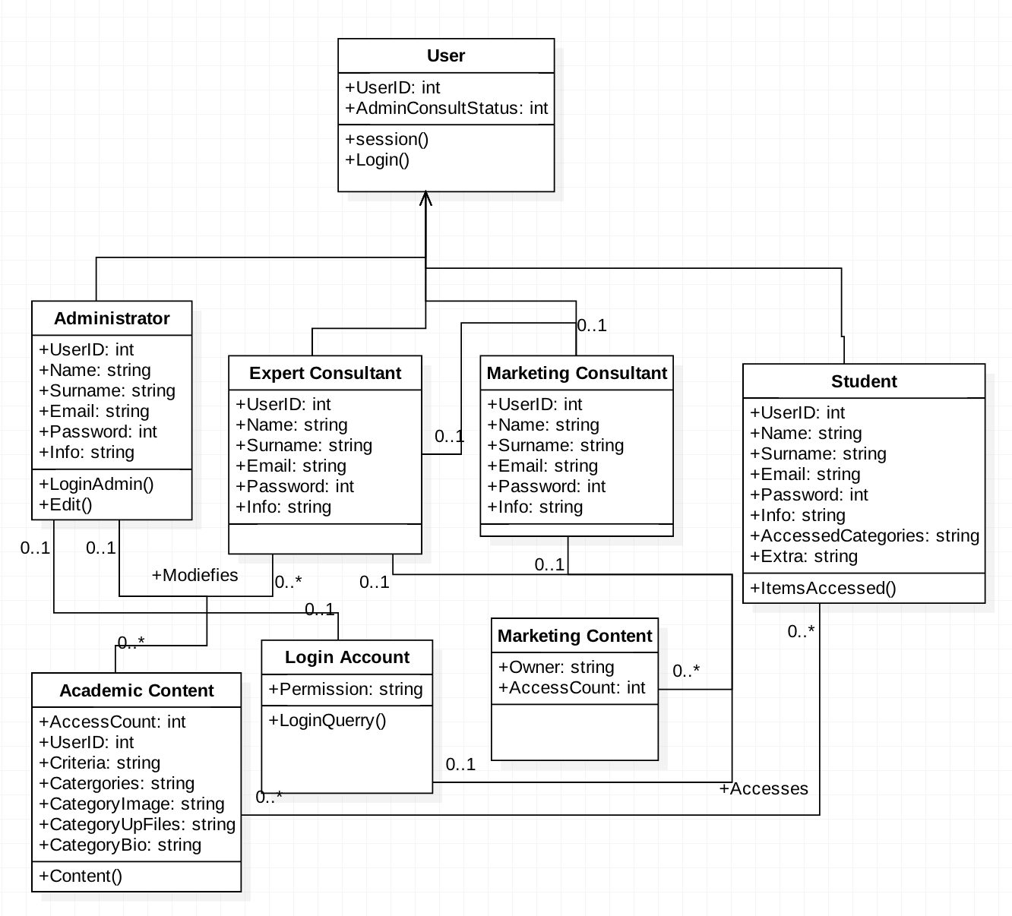
Domain Model

Slide 5
Requirements and Design outline
Functional Requirements
Login, signup
Upload media as admin
Manage media.
View media.
Manage criteria.
Search user.
Edit your profile.
Performance Requirements
Design
Constraints
Simple and intuitive graphical user interface (GUI) .
Avoiding Complicated, graphics intensive interfaces by using
simple interfaces that use minimal resources and storage space as required in order to cater for usability on our users different devices.

Slide 6
Requirements and Design outline
Reliability
Ability to cater for worst case scenarios such as larger data traffic during exams or test week.
Pay attention to the ability to connect to the site from a 2G mobile network catering for areas far from the Urban settlements
Maintainability
Allow modular, easy to maintain, update, alter during its life cycle.
A growth in web usage and data should not complicate the maintainability of the site.
Security
Secure registration and login via identification and authentication mechanism.
Protection of individuals profiles, freeing from Cyberstalking and Cyberbullying.
Portability
Web highly responsive and also mobile user friend
Data files small enough to be downloaded and sent between mobile phones saving users data.

Slide 7
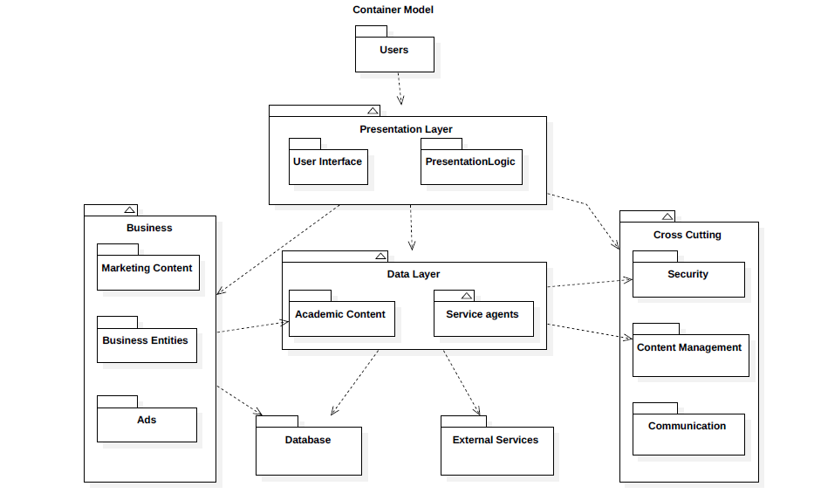
Package Diagram

Slide 8
Package Diagram

